Slide 1
History Heroes Term 1, Week 5
https://www.youtube.com/watch?v=lXgkuM2NhYI 0.50-1.00

Slide 2
Question 1 (2 marks)
Who was William Taft?

Slide 3
Question 2 (1 mark)
What year did America enter WW1?

Slide 4
Question 3 (2 marks)
What was one economic impact of WW1 on America?

Slide 5
ANSWERS

Slide 6
Question 1 (2 marks)
Republican President from 1908-1912.
Sought to end laissez-faire politics.
Believed in economic diplomacy, rather than military might.

Slide 7
Question 2 (1 mark)
1917

Slide 8
Question 3 (2 marks)
America’s economy boomed during WW1 as industries in Germany and Britain were halted by war and American companies supplied ammunition and food to the allies.

Slide 9
Total
/5

Slide 10


Source
of
the
week!

Slide 11
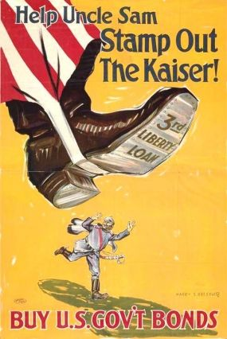
Circa 1917
H. Bressler
Imperial War Museum

Slide 12
Source analysis
Liberty loans - sold in the United States to support the allied cause in World War I.
Sold through commercial banks
Government needed money to finance the war
Third Liberty Loan campaign
Patriotic duty
Propaganda - information, especially of a biased or misleading nature, used to promote a political cause or point of view.

